Slide 1



Aviation PROJECT
Group Members
Madathala Satya Raj
Sumit Kumar Das
Gunisetty Harshitha
Rutuja Ranjendra Mahamunkar
Nilesh Changdev Borkar
Vijayavitthal R Balambeed

Slide 2
Agenda
Preparation
Overview
KPI’s
Dashboards
Challenges

Slide 3
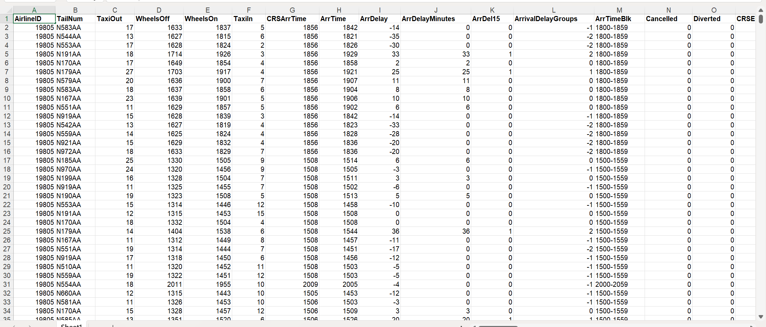
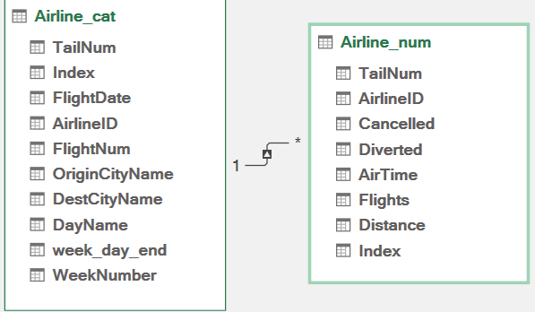
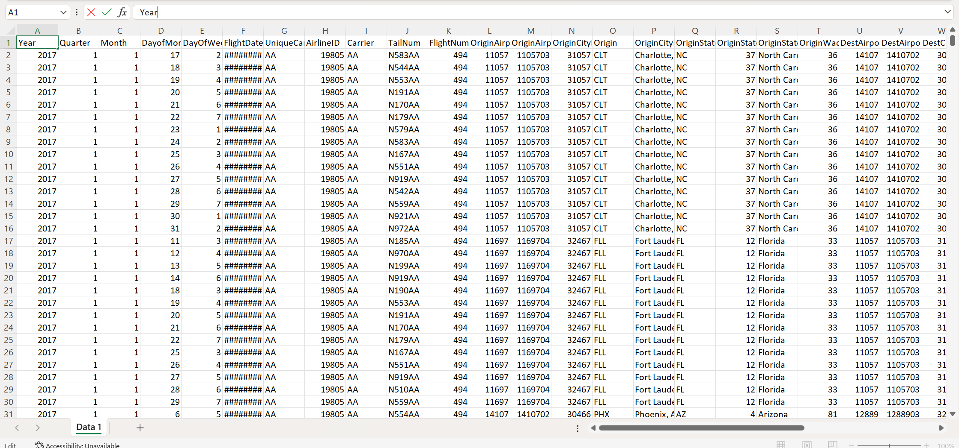
We have established connection between two tables and removed some of the columns which contains more than 80% null and blank values.
PREPARATION

Slide 4
OVERVIEW
INTRODUCTION :
In the evolving of the aviation industry, the performance checks of airline projects has been provided to assess the performance, operations, and analyze the aviation industry. Understanding the economic growth of aviation . This analysis aims to provide valuable insights for better decision making and strategic planning.
OBJECTIVE :
To provide the relevant information through some interactive visualizations by analyzing the data to assess the further better operations.
CONCLUSION :
In summary, our project will provide detailed information on how flights will work on a weekly basis, number of flights travelled, number of cancelled flights ,number of diverted flights and total distance covered. This result will help to perform better manage risk and better decision making for future flights.

Slide 5

KPI’s
Week-day Vs Week-end total flights.
Number of Cancelled flights for Honolulu, HI (Origin City )
Week-wise statistics of arrival of flights from Manchester ,NH and departure of flights from Manchester ,NH
Total distance covered by N190AA on 1ST January with Air Time 50

Slide 6
KPI 1 : Week-day vs week-end total flights
OBSERVATIONS :
Total Flights on week-days is 206k.
Average Flights per week-day is 9.3k.
Total Flights on week-ends is 75k.
Average Flights per week-end is 8.3k.
CONCLUSION :
An airline launched the best flight deals on weekdays compared to weekends. This could lead to the highest number of flights deals on weekdays. The flight prices on Saturday and Sunday were higher on average than flights on Monday to Friday.

Slide 7
KPI 2 : NUMBER OF CANCELLED FLIGHTS FOR HONOLULU, HI (origin city)
OBSERVATIONS :
Cancelled flights from Honolulu ,HI (Origin City) is 8.
Half of the cancelled flights is scheduled to the nearby cities in the same state and travel distance is around 100km.
POSSIBLE REASONS :
Due to lack of bookings to nearby cities in the same state.
Alternate Mode of transport is preferable for shorter distances.
FlightNum | DestCityName | Distance | Sum of Cancelled
14 | Newark, NJ | 4962 | 1
183 | Lihue, HI | 102 | 1
246 | Kahului, HI | 100 | 1
353 | Lihue, HI | 102 | 1
356 | Kahului, HI | 100 | 1
693 | Phoenix, AZ | 2917 | 1
834 | Portland, OR | 2603 | 1
1212 | Los Angeles, CA | 2556 | 1
Grand Total |  |  | 8

Slide 8
Kpi 3 : Week wise statistics of arrival of flights from Manchester and departure of flights of flights to Manchester ,nh
DEPARTURE FLIGHTS (Manchester ,NH)
OBSERVATIONS :
Highest number of flights(above average) were departed from Manchester ,NH in the 3rd week of January is 81.
Lowest number of flights(below average) were departed from Manchester ,NH in the 5th week of January is 34.
Average number of flights were departed from Manchester ,NH in the remaining weeks is 60.
POSSIBLE REASONS :
Discounted prices on tickets in the middle of the month on weekdays.
Last week of the month results in lowest number of flights.

Slide 9
ARRIVAL FLIGHTS (Manchester ,NH)
OBSERVATIONS :
Highest number of flights(above average) were arrived at Manchester ,NH in the 3rd week of January is 74.
Lowest number of flights(below average) were arrived at Manchester ,NH in the 5th week of January is 37.
Average number of flights were arrived at Manchester ,NH in the remaining weeks is 55.
POSSIBLE REASONS :
Discounted prices on tickets in the middle of the month on weekdays.
Last week of the month results in lowest number of flights.

Slide 10
Kpi 4 : Total distance covered by n190aa on 1st January with air time 50
OBSERVATION :
Distance travelled by Flight (639) with Tail Number N190AA and Air Time 50 is 304km.
Reasons :
Average flight distance with around airtime 50 is 288km in our case flight travelled 16km more may be due to good weather conditions/light traffic.
Flight Date | Tail Num | AirTime | Flight No | Origin City | Dest City | Distance
01-01-2017 | N190AA | 50 | 639 | Phoenix, AZ | San Diego, CA | 304

Slide 11
KPI 5 : Day-wise total flights ,Cancelled and diverted flights
OBSERVATIONS :
Maximum Flights(13,523) on 5th day (Thursday) of second week i.e.12-01-2017.
Average Flights in whole month is 9,060
Minimum Flights(2952) on 7th day (Saturday) of second week i.e.14-01-2017.
Maximum Cancelled Flights(1,282) on 7th day (Saturday) of first week i.e. 07-01-2017.
Average Cancelled Flights in whole month is 195
Minimum Cancelled Flights(8) on 5th day (Thursday) of fourth week i.e. 26-01-2017.
Maximum Diverted Flights(130) on 1st day (Sunday) of fourth week i.e. 22-01-2017.
Average Diverted Flights in whole month is 29
Minimum Diverted Flights(2) on 5th day (Thursday) of fourth week i.e. 26-01-2017.

Slide 12
KPI 6 : Distance Vs Air Delay (>= 15 minutes)
OBSERVATIONS :
From the graph ,we can observe that as the flight travel distance increases arrival delay (>= 15 minutes) also increases.
Correlation Coefficient = 0.899207
POSSIBLE REASONS :
Bad weather conditions.
Higher traffic in that route.
Unprecedented problems.

Slide 13

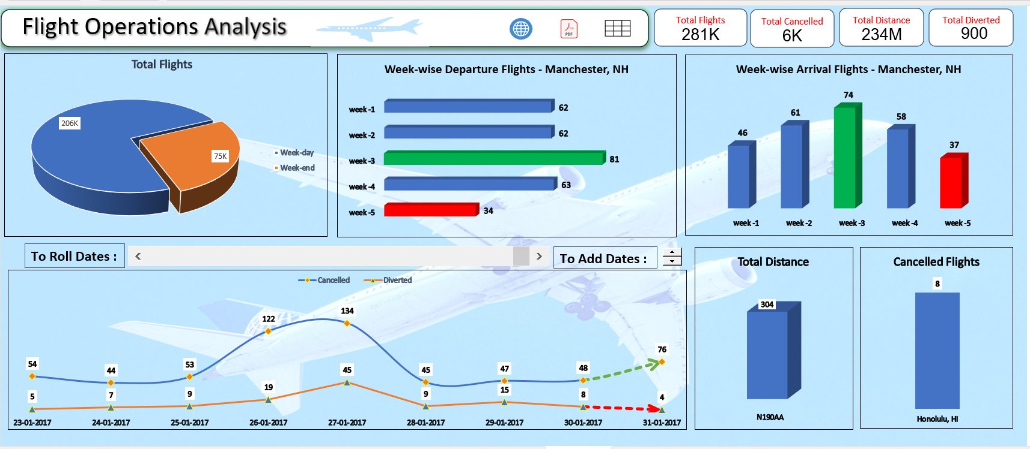
EXCEL dashboard

Slide 14
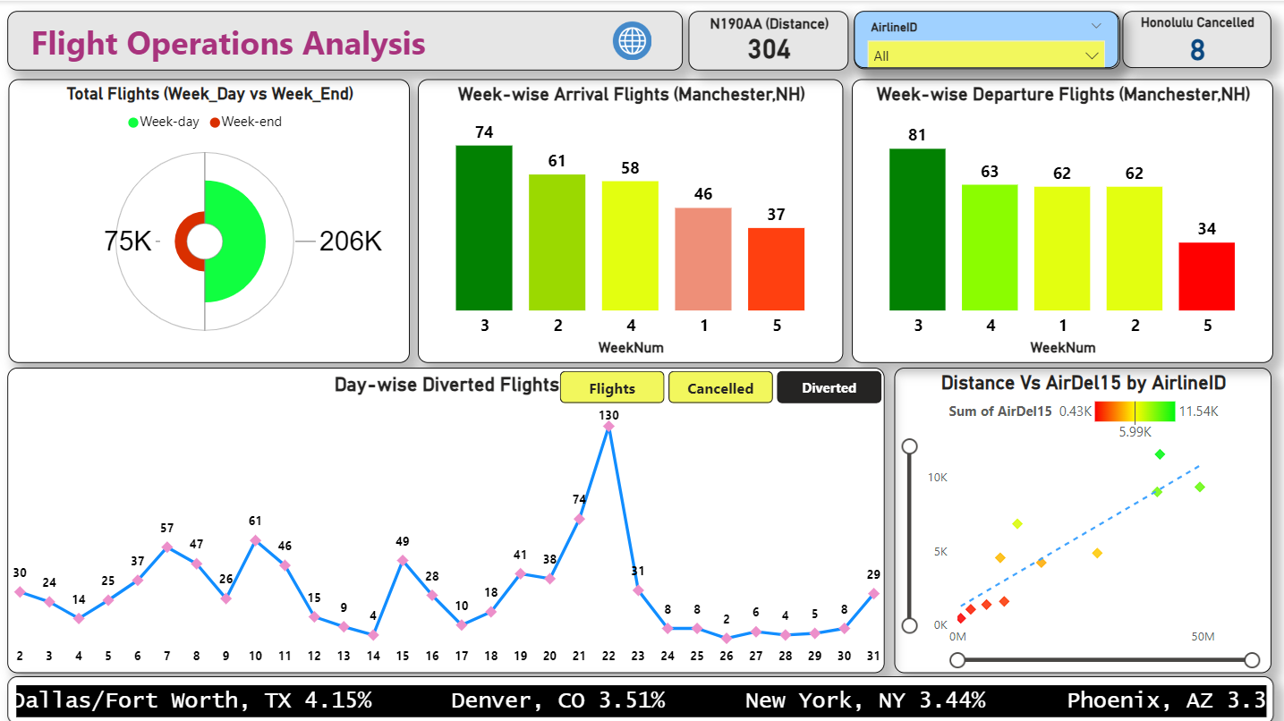
Power bi dashboard

Slide 15
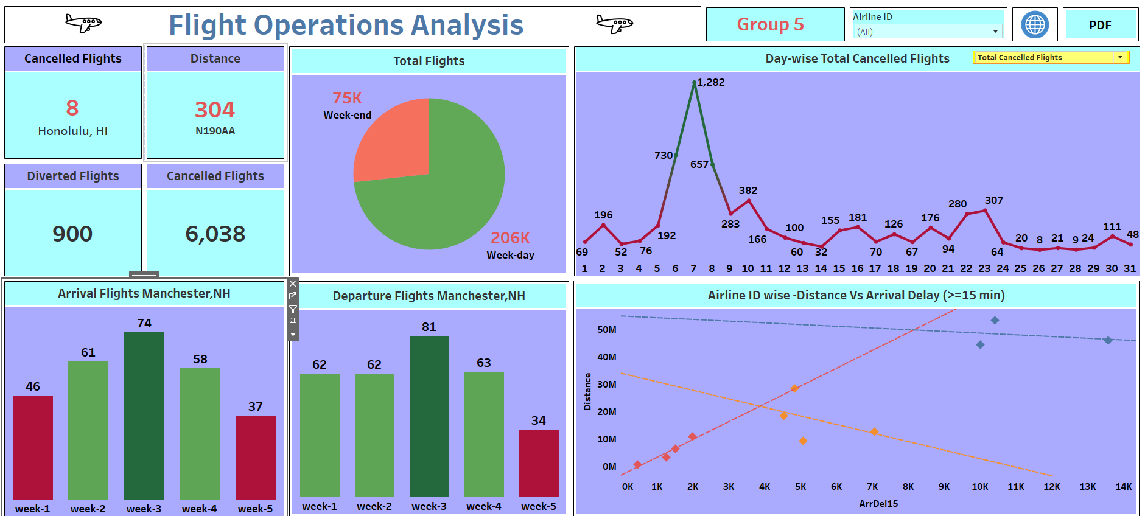
TABLEAU DASHBOARD

Slide 16
CHALLENGES
Merging the Tables
We faced tough challenge initially to merge tables which are having duplicate and blank values in common columns. We created unique index column for both the tables to overcome this problem.
Making Relationship
We faced tough challenge initially to make relationship between tables which are having duplicate and blank values in common columns. We created unique index column for both the tables to overcome this problem.
Importing large files to MySQL
Importing large csv files to MySQL takes lot of time to overcome this problem we created text files using python and then by using insert statement created tables.
Dealing with null and blank values/records
We faced a challenge of having large number of blank records in dataset by using power query cleaned the dataset and removed the unwanted columns which are having 80% of null and blank values.

Slide 17

Thank You

